Slide 1
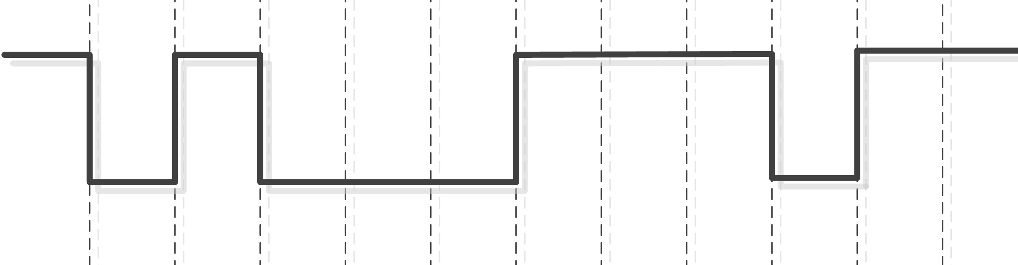
Early Communication
Parallel and Serial Communication
Synchronous and Asynchronous Communication
Modulated Signal Communication – IR reciever
Part Two of Arduino Program

Slide 2
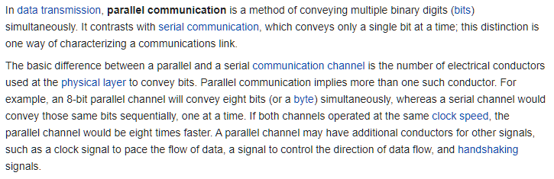
Parallel Communication

Slide 3
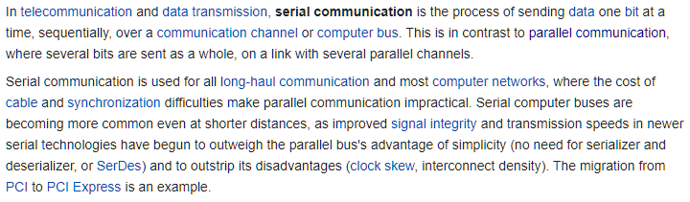
Serial Communication

Slide 4
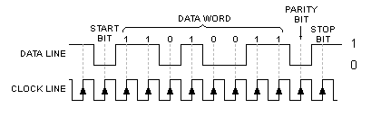
Communication Synchronization

Slide 5
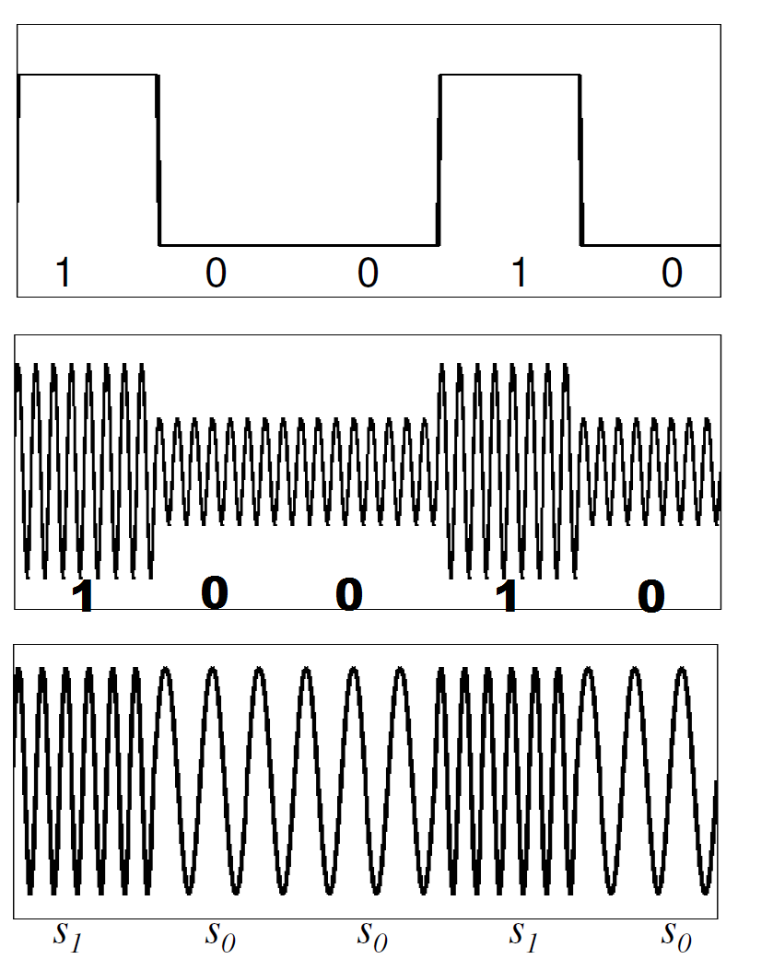
Pulse Modulated Communication
Designated Signal
Amplitude Modulated Signal
Frequency Modulated Signal

